Slide 1
Game “Jasmin 2048”
Mathematics says: "The sum does not change from changing the places of the terms." But for the game "2048" this law does not apply

Slide 2
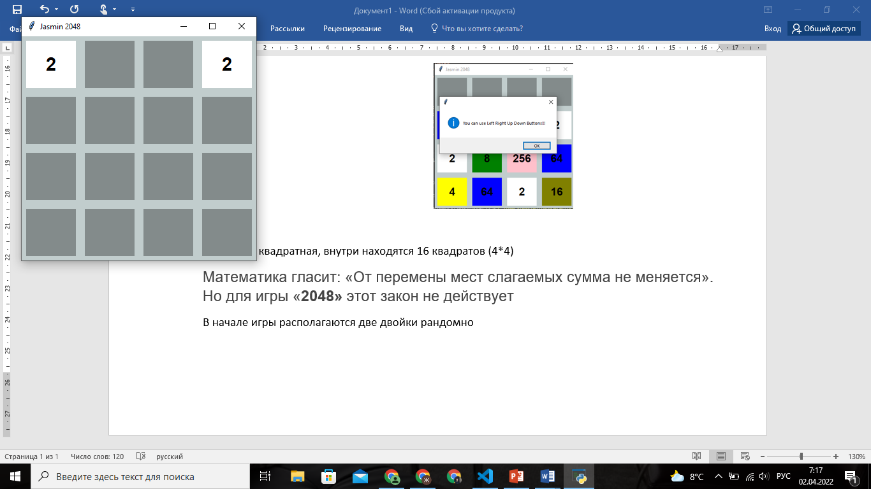
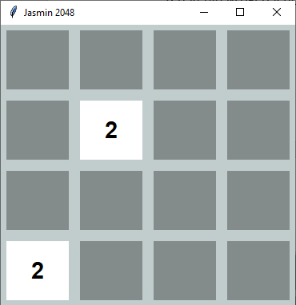
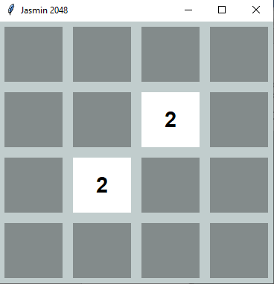
The game window is square, inside there are 16 squares (4*4) At the beginning of the game , two “2” are placed randomly

Slide 3
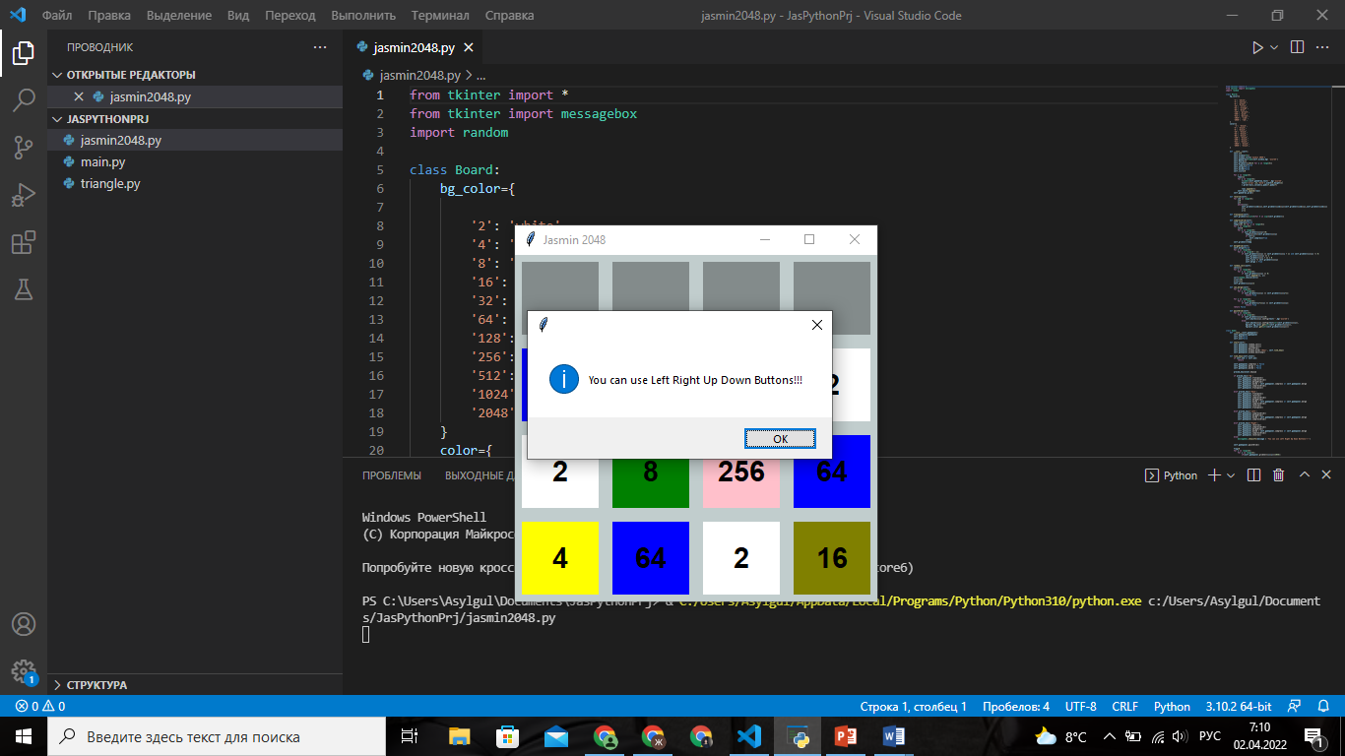
In this game we can only press 4 buttons “Left Right Up Down”, otherwise, a window with the inscription will appear “You can use Left Right Up Down Buttons!!!”

Slide 4
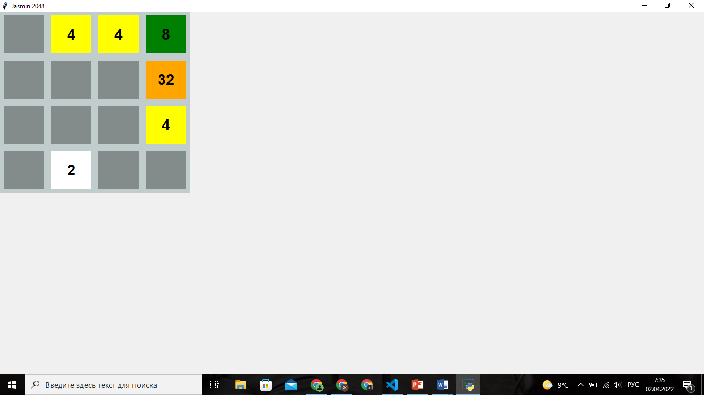
Pressing the button (right, left, up, down) in the direction of two adjacent identical numbers will result in their summation On the 4x4 cell field, after the next click (left, right, up and down), one new “2” randomly

Slide 5
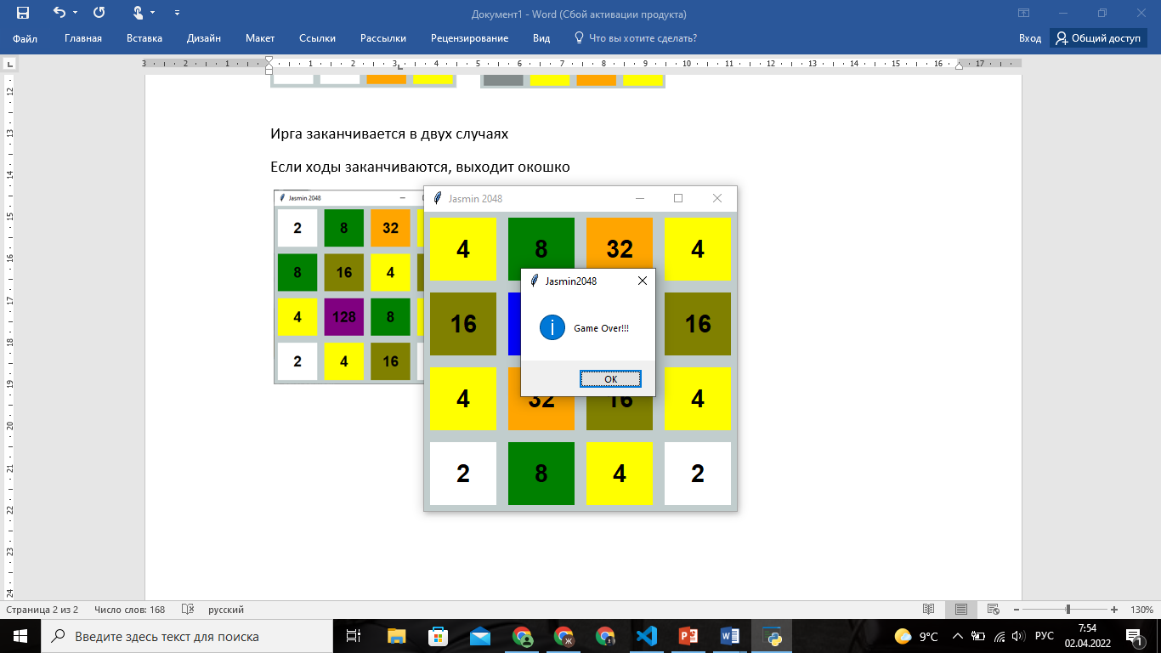
The game ends in two cases
If the moves end, the window “Game Over!!!”
If you reach 2048 in the game, then the inscription comes out, "You Wonn!!"

Slide 6
Thank you for your attention
Jasmin Duishebaeva
Math 21

